Slide 1

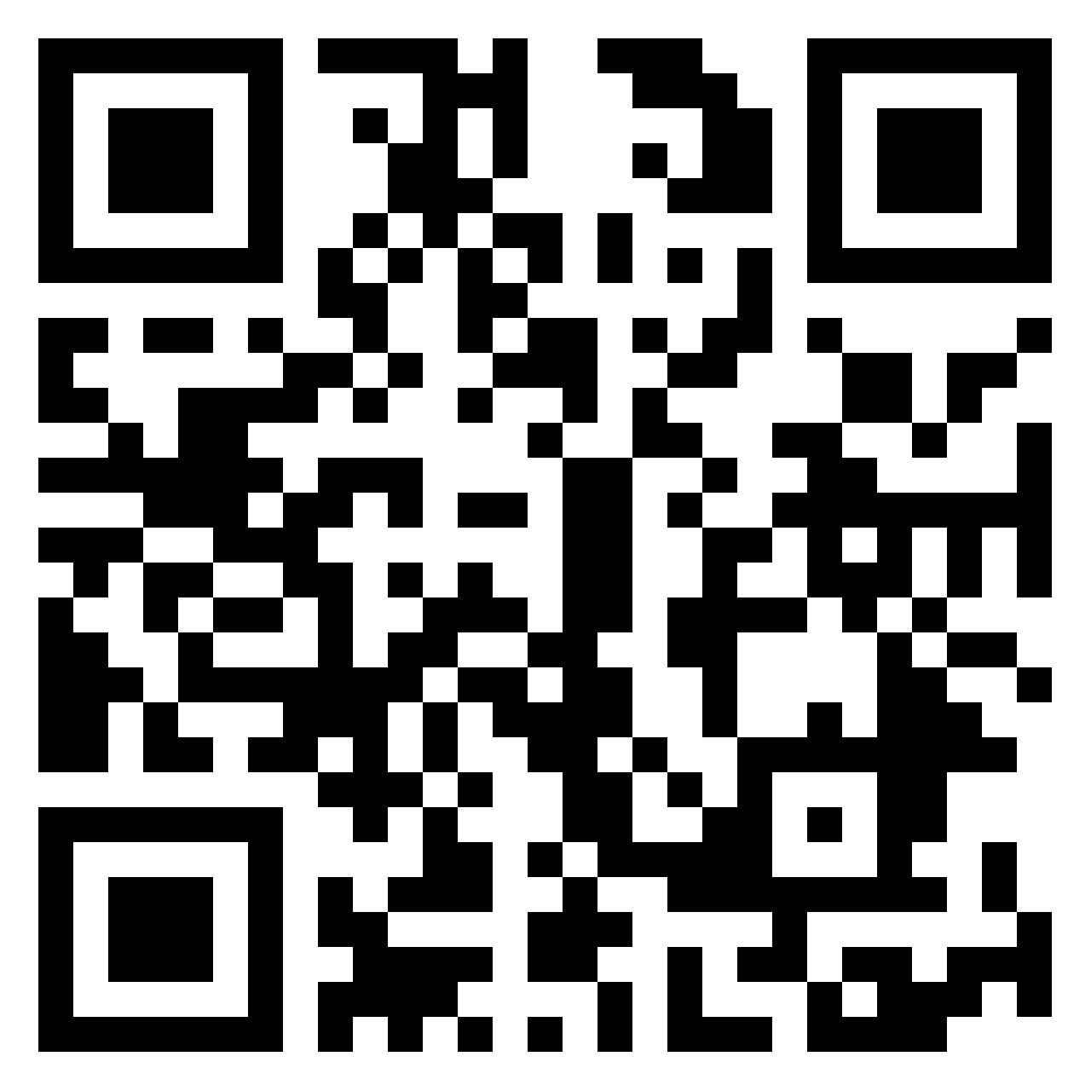
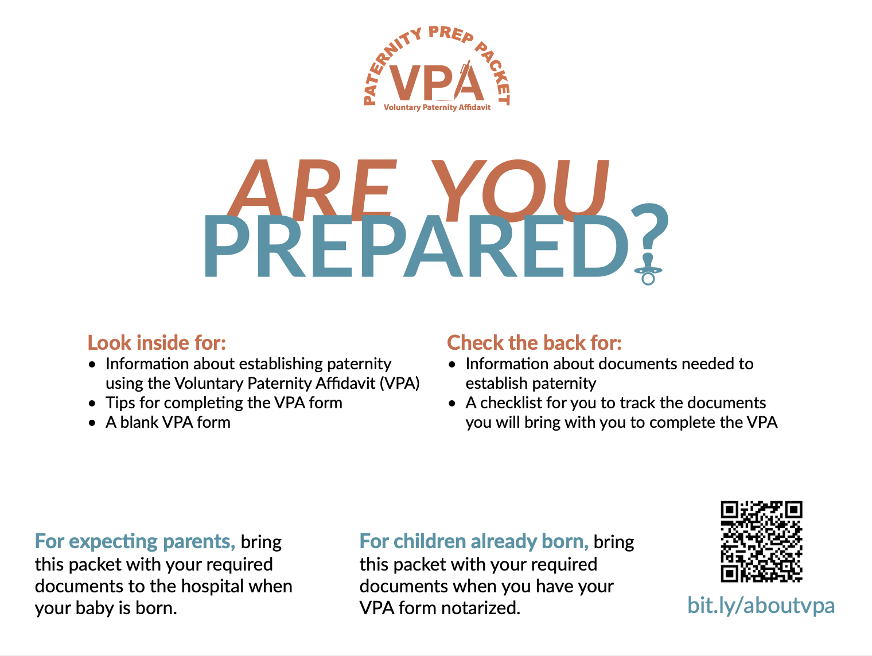
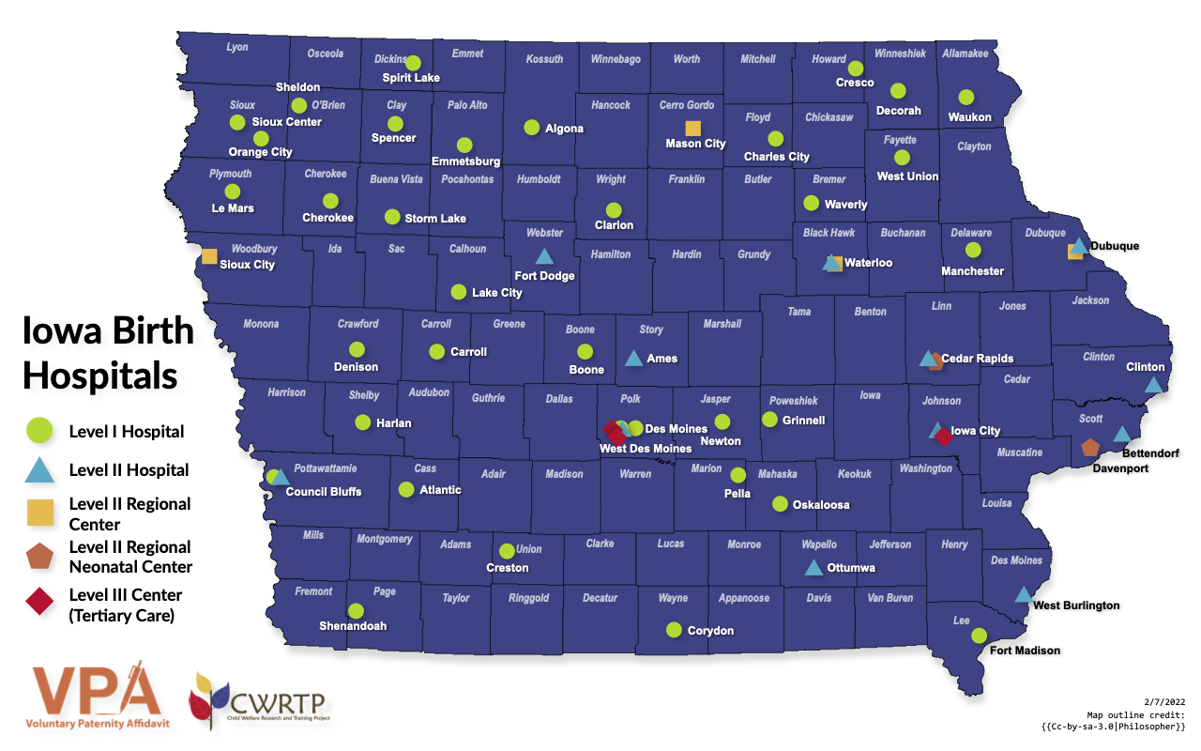
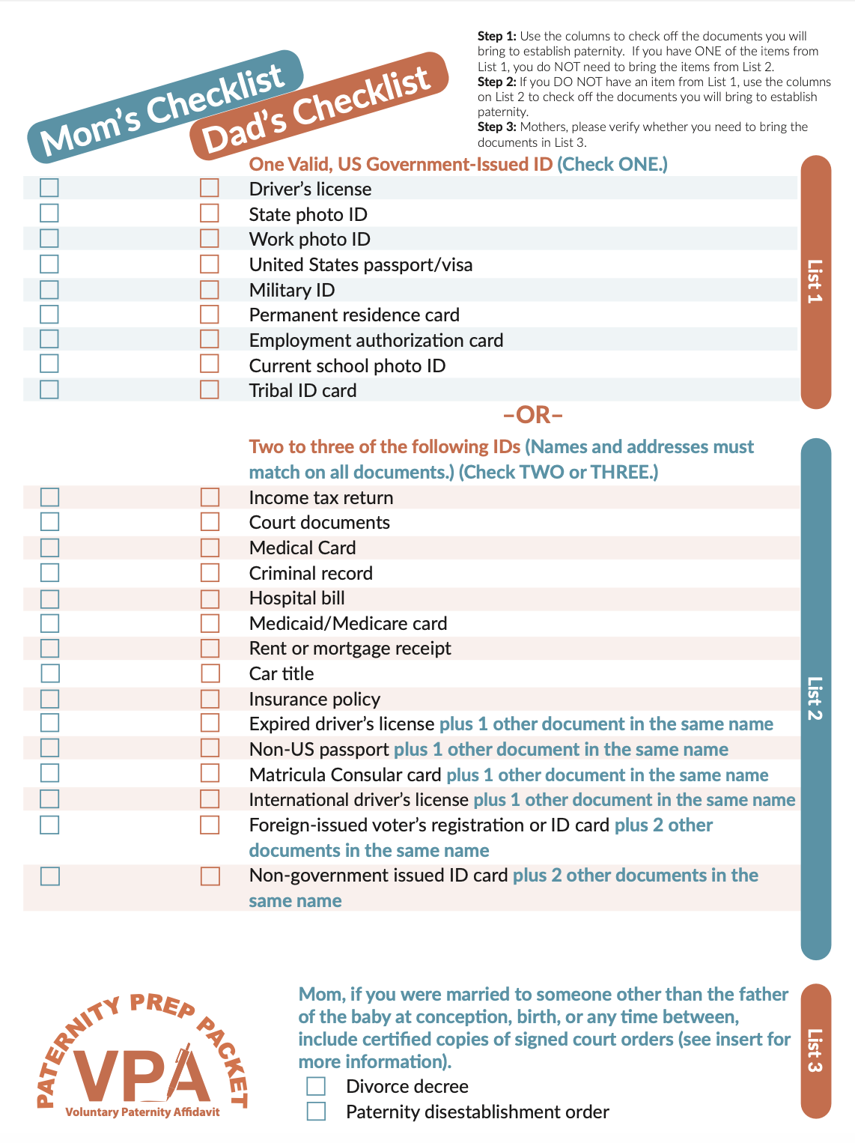
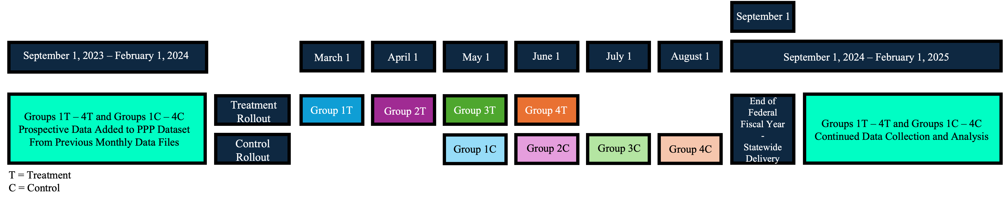
The Impact of the Paternity Prep Packet on Voluntary Paternity Affidavit Errors:
A Multiple Baseline Study
Scan the QR code to submit questions and comments on Padlet! Your post will be responded to real-time as a comment!
November 2024
Alison C. White, Daeyong Lee, Carl Weems, Jan Melby
Background
The Packet
Methods
Establishing legal paternity may enhance children’s socioemotional and academic outcomes by promoting father involvement.
The study utilized a multiple baseline design. All 57 birthing hospitals in Iowa were intentionally paired based on VPA volume. Then, hospitals were randomly sorted into four groups. The PPP intervention was staggered in rollout from March 2024 – August 2024.
VPA rejection data is collected by and received from BHS monthly. This data reports rejection reasons for every rejected VPA from the month prior. This data has been received by our workgroup since 2017 and is ongoing.
In addition to sending samples of PPPs in English and Spanish to all birthing hospitals, we also sent them to each birthing hospital’s surrounding prenatal providers.
Paternity establishment also has implications for Iowa’s state funding. If Iowa does not reach its paternity establishment goal every year, it is at risk of losing out on federal TANF funding.
Rollout Design
Data from the Iowa Bureau of Health Statistics (BHS) indicates identification errors (e.g., lack of valid proof of identity) is a leading cause of VPA rejections.
Preliminary Findings and Future Directions
Preliminary findings indicate a small, but nonsignificant decrease in the number of identification errors post-intervention.
Future Direction 1
Future Direction 2
The PPP is printed on a 9”x12” envelope, encouraging parents to put their indicated identification documents inside to bring when it is time to establish paternity.
The Paternity Prep Packet (PPP) was developed to mitigate identification errors and ultimately reduce VPA rejections, thereby increasing paternity establishment, through targeted outreach to individuals through their prenatal and obstetric providers.
The data received from BHS does not report the total number of VPAs submitted by each hospital per month. Thus, we sought to develop a proxy variable to represent the total number of VPAs submitted by each hospital per month.
In order to create a more nuanced picture of the potential impact of the PPP, we are looking into our archived data to add six months of pre-intervention data (since September 2023) into our dataset. Additionally, we are continuing to enter data into our study’s dataset (until February 2025).
Using public data, we identified variables that allowed us to calculate a variable that represents an estimate for monthly births by county for 2024 based off 2023 birth rates.
Adding six months of pre-intervention data will allow us to better analyze trends and estimate the mean VPA rejection rates before intervention.
The PPP comes with information about legal paternity, tips and tricks for completing the VPA, and a blank practice VPA.
The inclusion of a proxy variable for total VPAs submitted will give a frame of reference for the rejected VPAs, highlighting the proportion of total VPAs submitted that get rejected, versus the absolute number.
Adding six months of post-intervention data will allow us to understand the PPP’s long-term effectiveness.
The purpose of the present study is to assess the effectiveness of the PPP in reducing identification-related errors in VPA submissions and the overall number of rejected VPAs.
The PPP can now be ordered from our ordering website for FREE. We have sent out about 10,000 PPPs this year between our sample shipments and subsequent orders.
Impact
This study has the potential to improve paternity establishment outcomes for unmarried parents by reducing identification errors in VPA submissions, which could serve as a model for state and national programs, ultimately enhancing child welfare funding and support.
The Iowa State University Child Welfare Research and Training Project conducted this work through a contract with the Iowa Department of Health and Human Services (BOC-24-003, Carl Weems PI).

